Slide 1
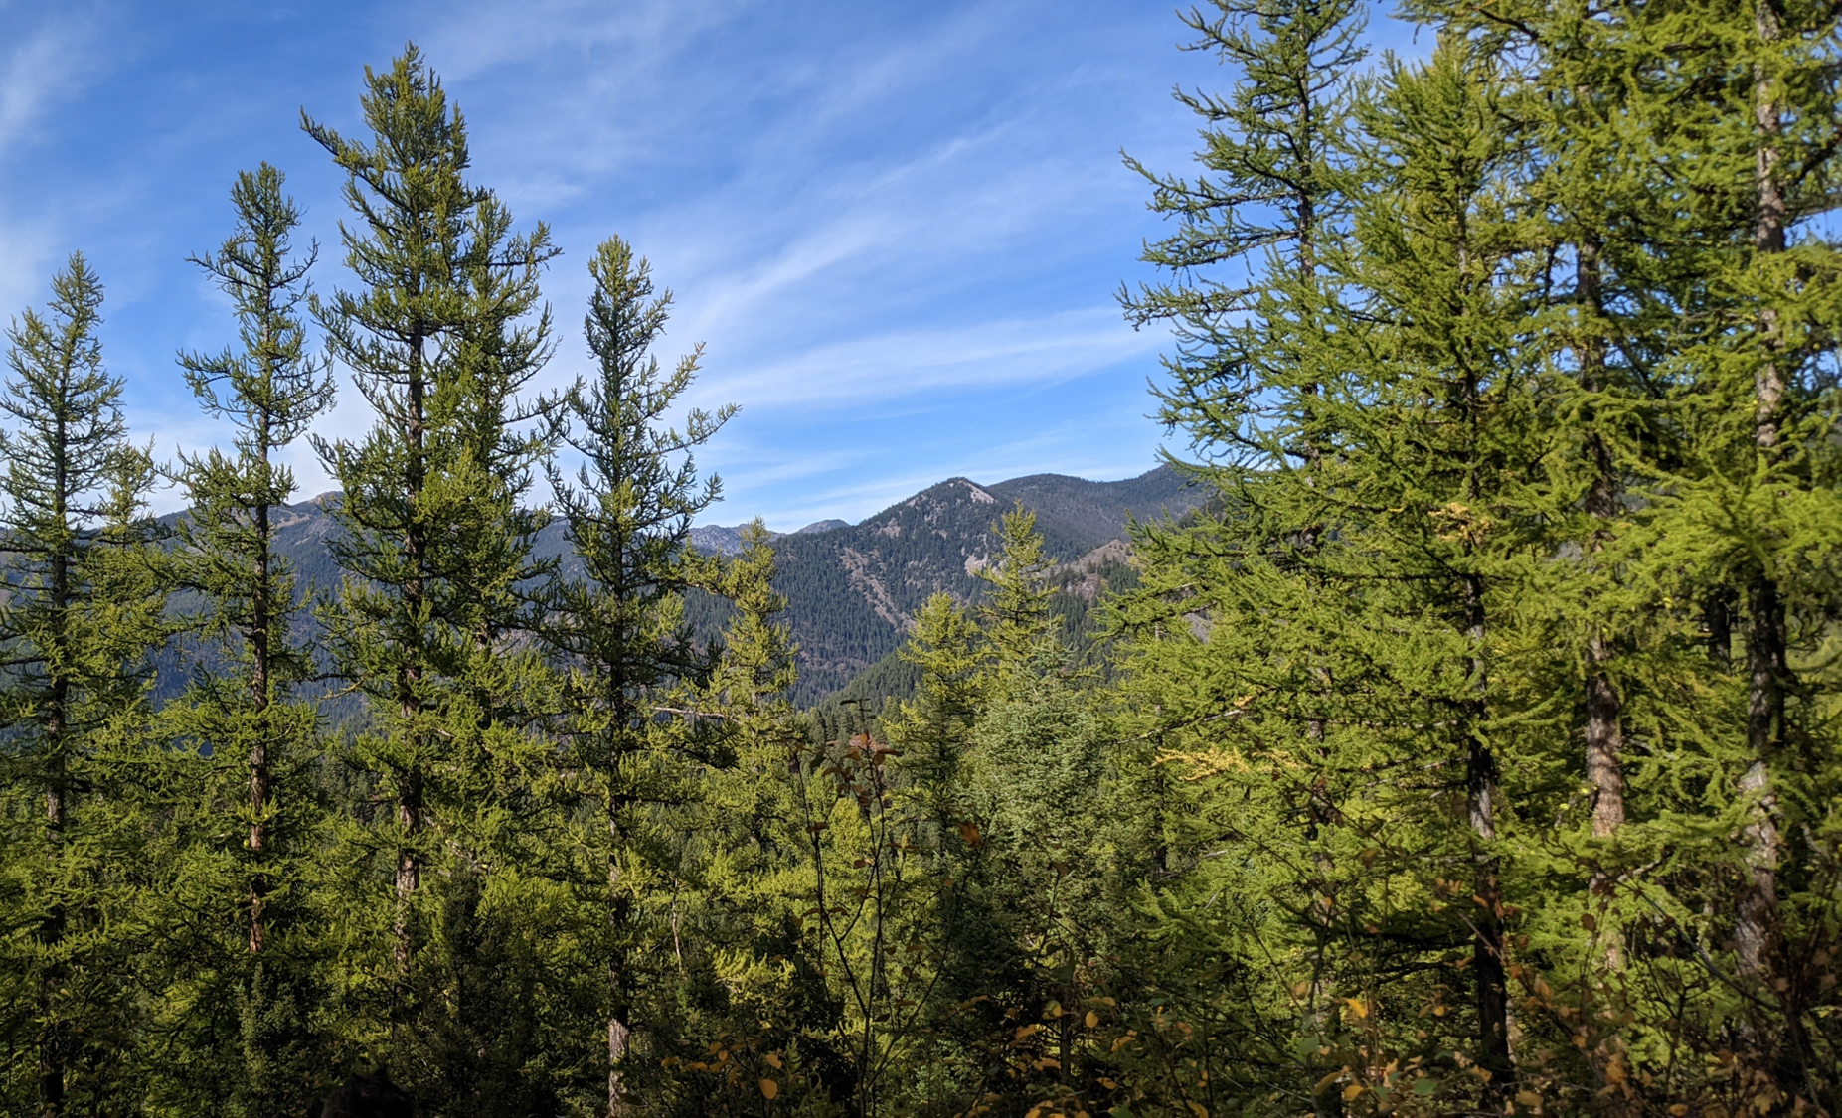
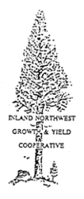

Evaluating the effects of forest community composition on western larch growth
Christian Mercado
Committee: David Affleck, Andrew Larson, Justin Crotteau, David Patterson
University of Montana, Missoula, MT, USA
Notes:
<intro>

Slide 2
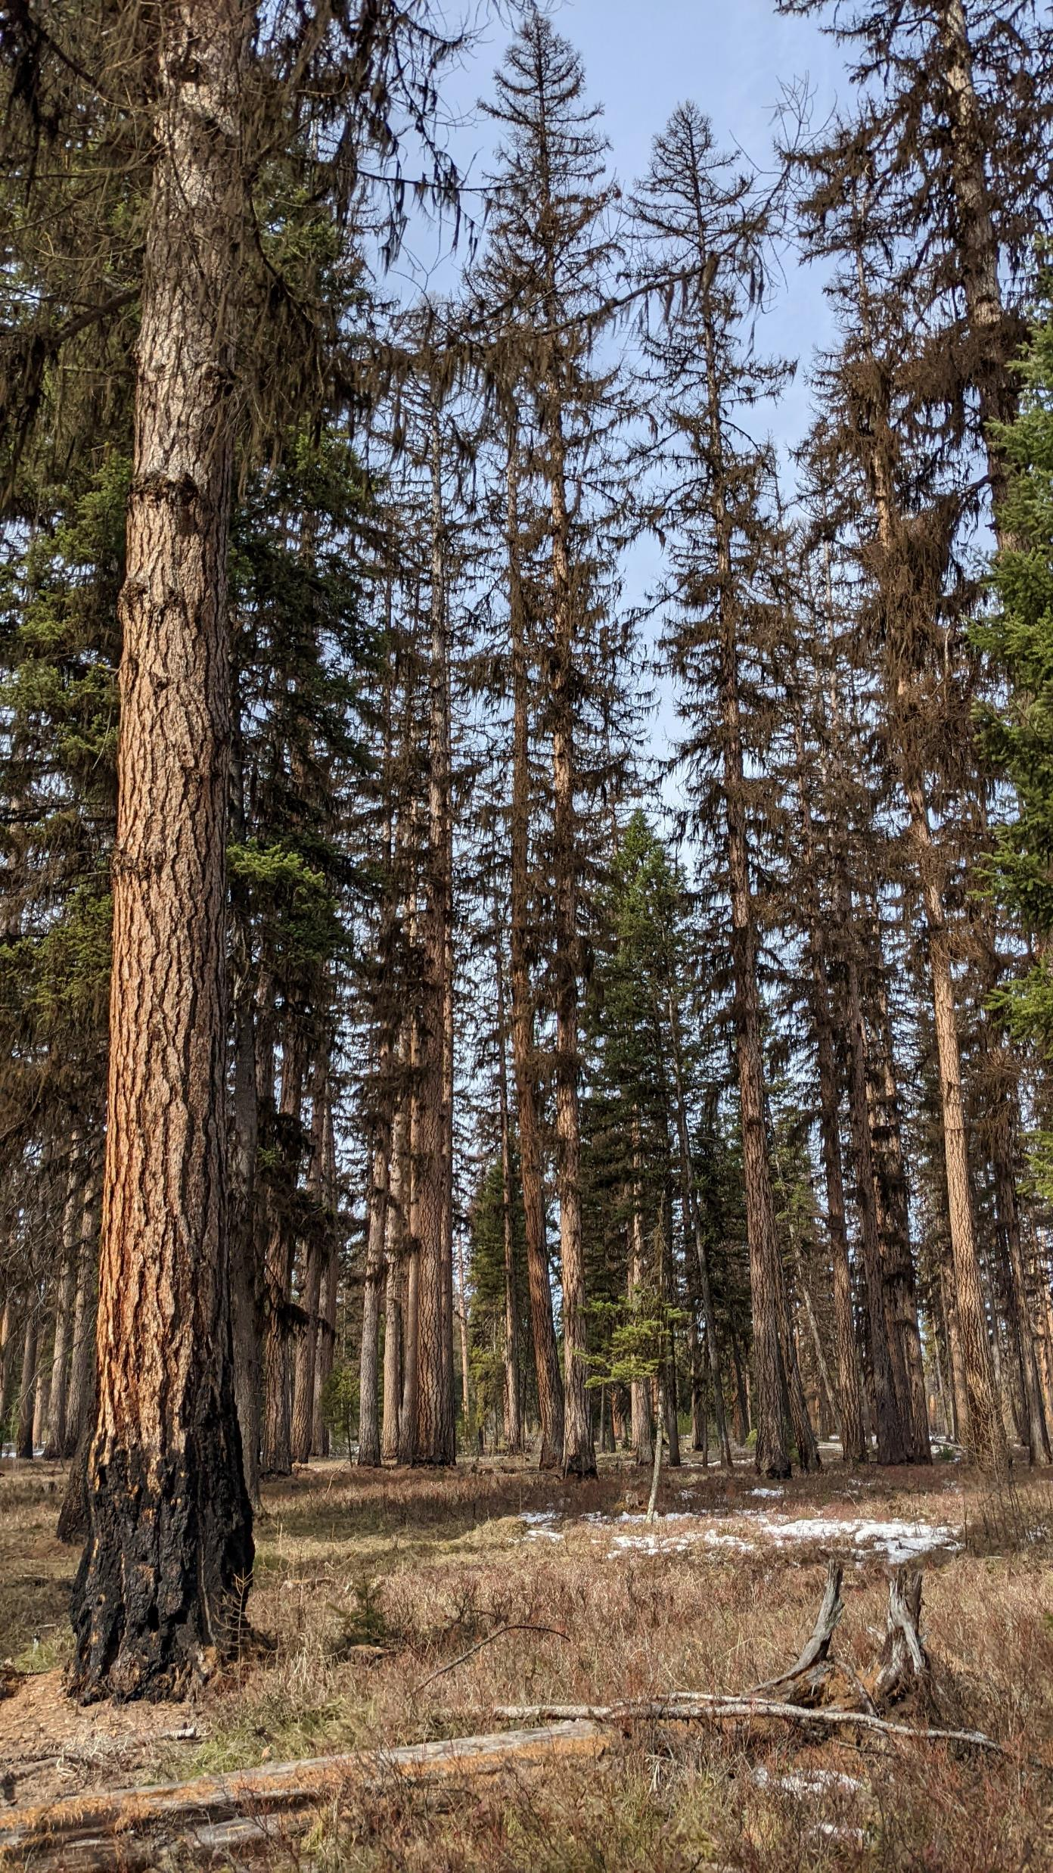
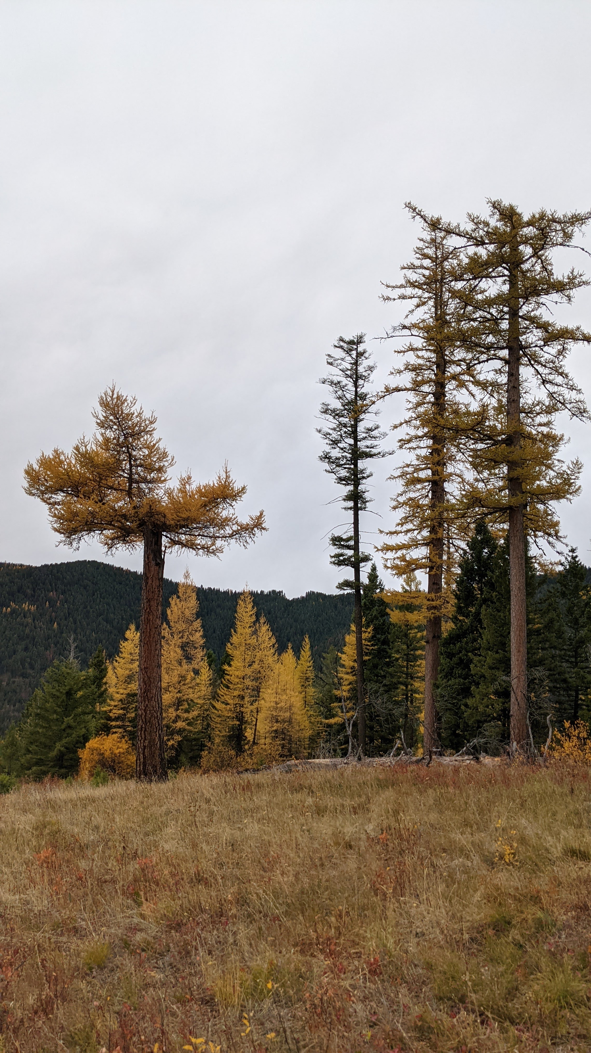
Larix occidentalis – Western larch
Notes:
Western larch (Larix occidentalis) is a deciduous conifer that grows exclusively within the inland northwestern region of North America. It is akin to Larix laricina, or eastern larch, however unlike its eastern counterpart, western larch holds considerable timber value. It generally grows tall and straight and can grow to large diameters with heights well over 100 feet. its lumber is mixed with that of douglas-fir.
Western larch grows at various elevations, spanning across subalpine environments.
It is also very intolerant of shade, has thick bark, and establishes prolifically after fire in mineral soil, making it both fire resistant and resilient.

Slide 3
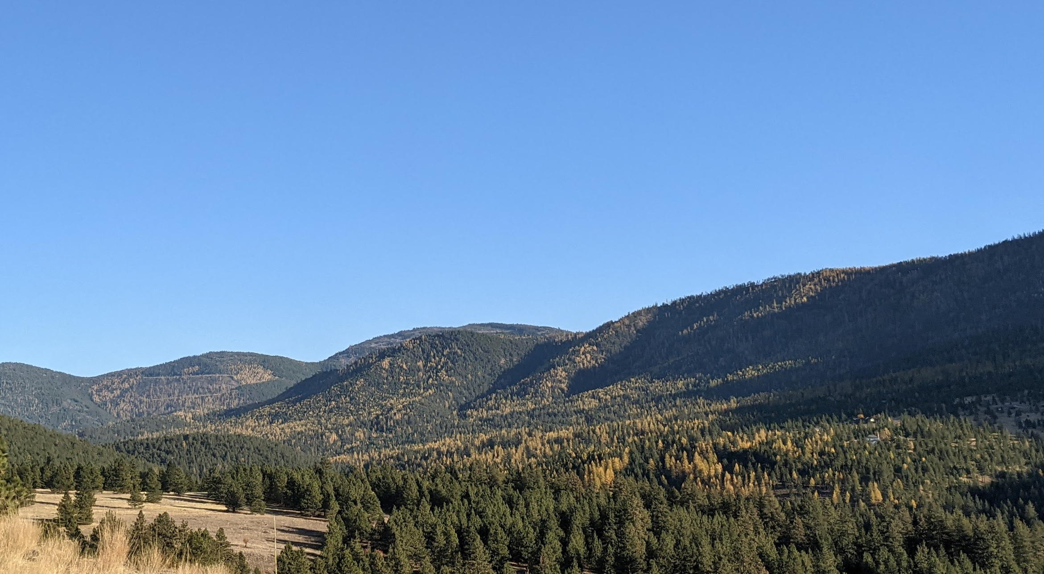
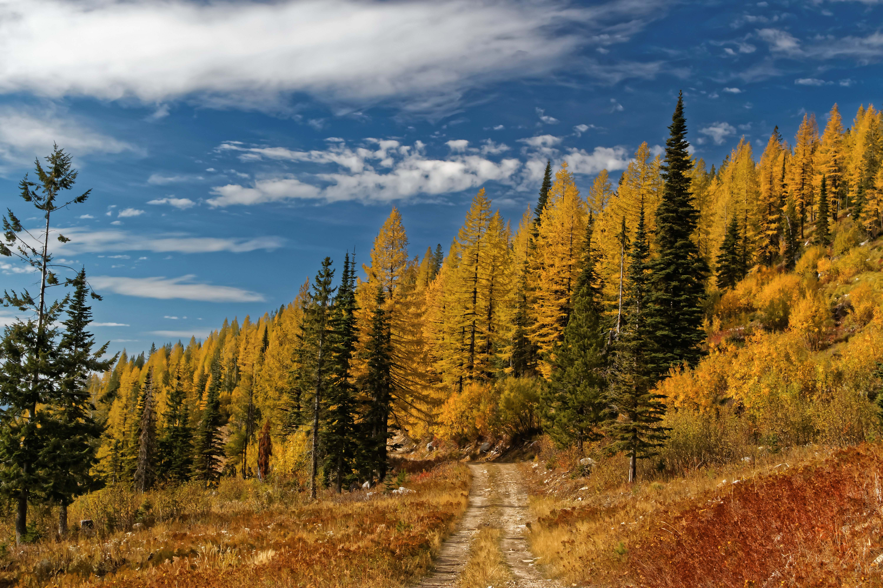
Larix occidentalis – Western larch
Notes:
In each of these photos, larch is revealed by a golden-yellow color. It naturally occurs across a range of forest species community compositions: sometimes as a minor component of a forest like in the left photo, all the way to pure stands, like in the photo on the right.
Recent research has shown that forest species composition, or species-mixing, can impact the growth of trees and stand yield, but until now, no such research has evaluated the impacts of species composition on the growth of western larch.
Various models, such as those in FVS, have characterized how western larch grows, however, these models don’t explicitly account for species-mixing impacts.

Slide 4
Questions
After accounting for other factors, how does community composition impact the growth of western larch?
How can species-mixing effects be captured within an individual tree growth model?
Notes:
Provided with this information, my primary questions were:
How does community composition impact the growth of western larch once all other influencing factors are accounted for?
And
How can the effects of species-mixing on growth best be captured within an empirical individual-tree growth model?

Slide 5
Objectives
Identify a growth model (without species-mixing)
Identify differences in larch growth between mixtures and pure larch conditions
Compare different measures of species-mixing in the model
Notes:
The associated objectives were then to
Identify a growth model without species-mixing information
This model would then be used as a basis for subsequent analyses
Identify differences in the growth relationship of western larch in mixed-species communities compared to those of western larch growing in ‘pure larch’ conditions.
And then to compare different generalizable species-mixing variables

Slide 6
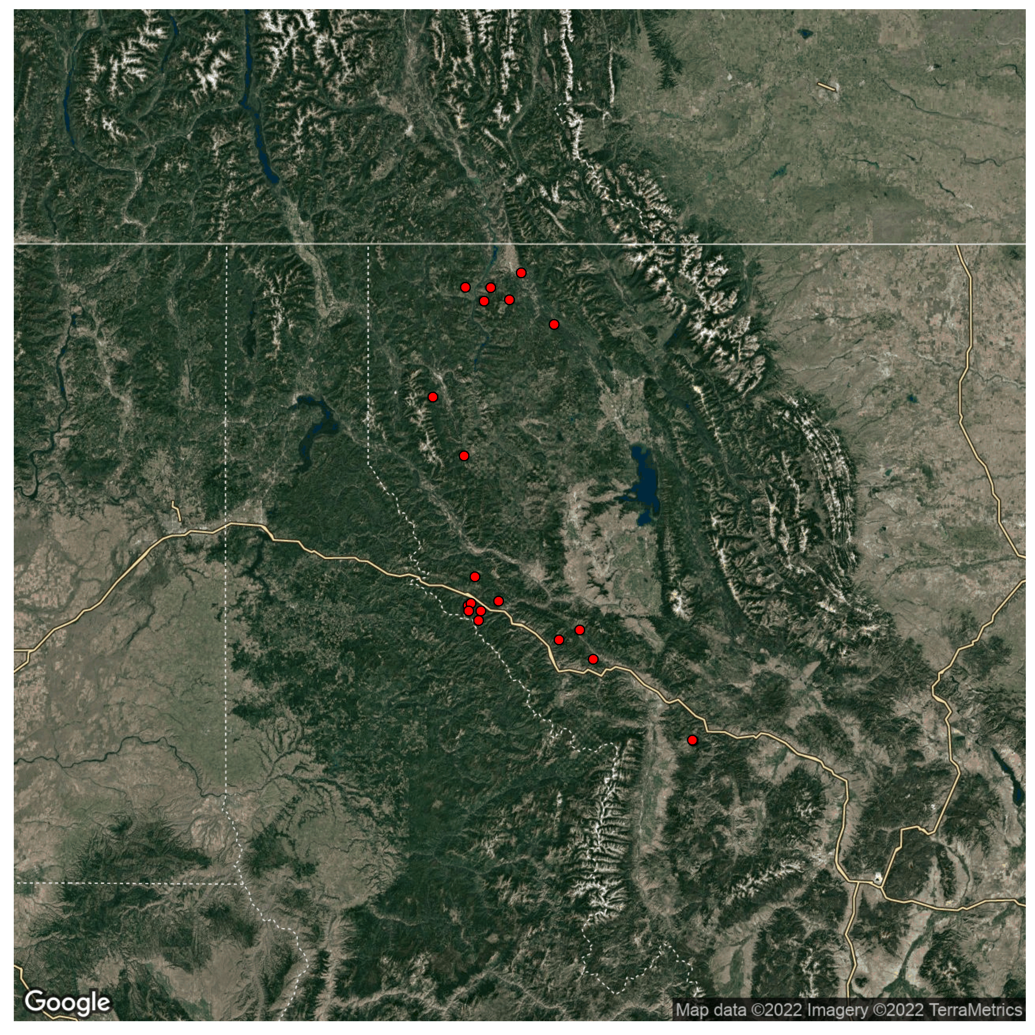
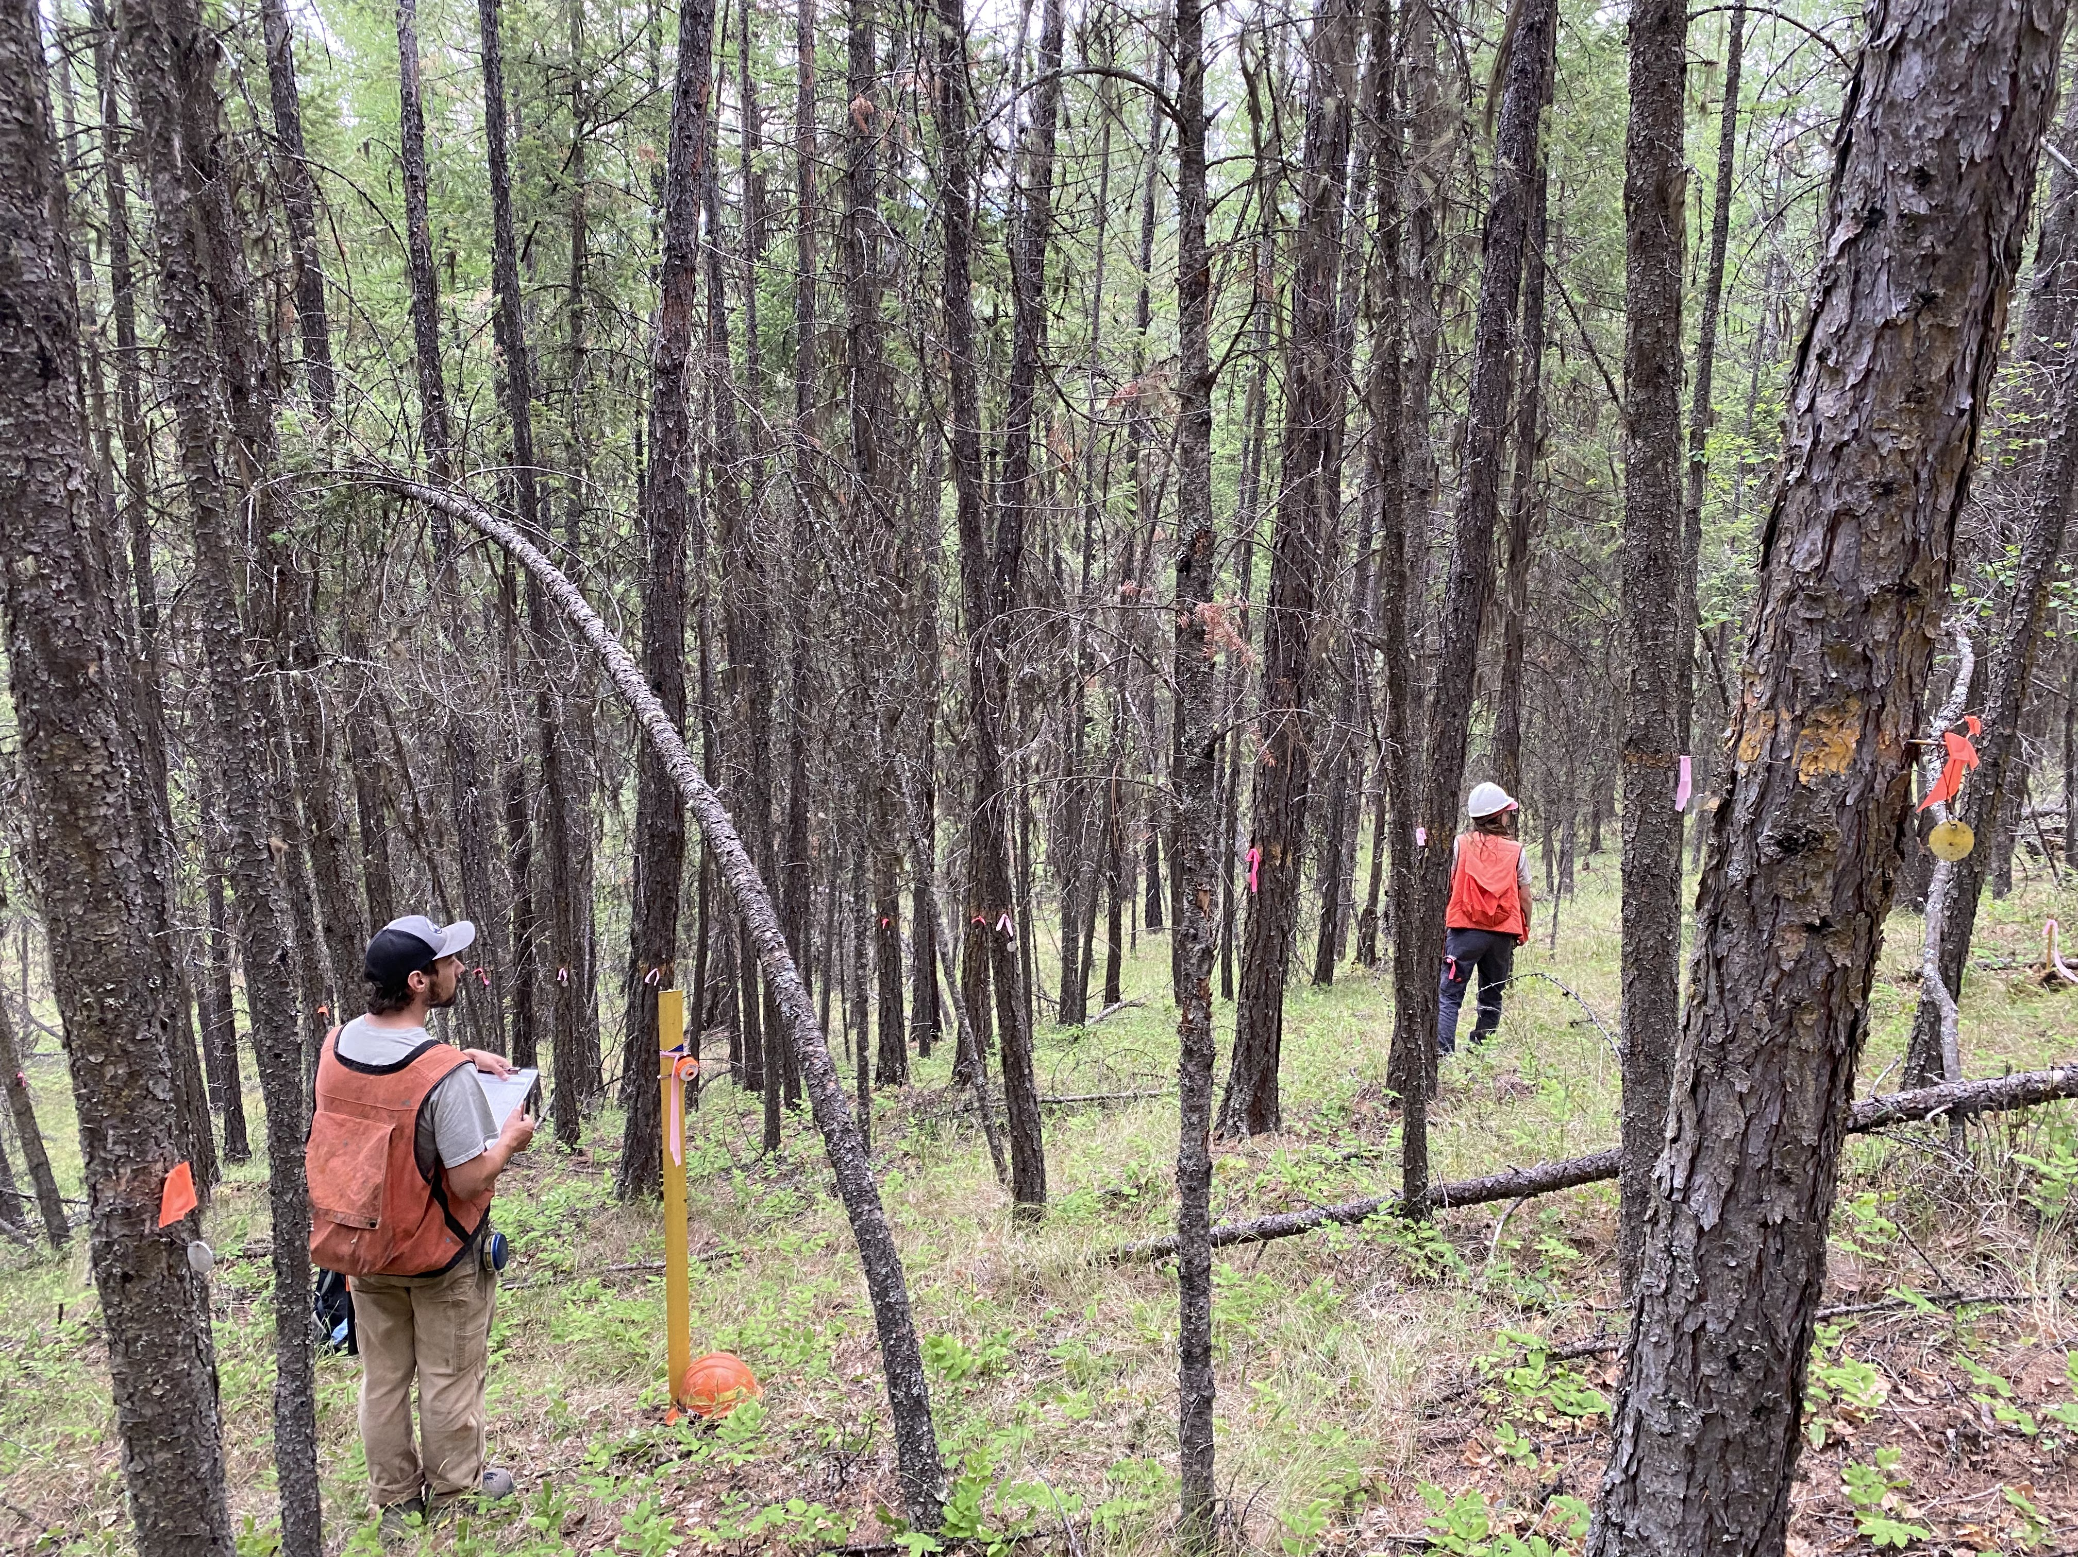
PGP Data
Permanent Growth Plots
18 stands on 2 National Forests in Montana
Canada
USA
Montana
Washington
Idaho
Notes:
All models were informed by a long-term data set which consists of repeat measurements on trees within 18 forest stands in northwestern Montana.
The map here shows the rough locations of study areas used, where each dot represents a stand. Site conditions like slope, aspect, and elevation were variable across stands in the data set.
These data are part of a larger network of permanent growth plots (or PGP’s) that were installed in the 1980’s to monitor tree growth in response to thinning.
Given this, each stand contained 4 plot clusters, 3 were treated with thinning (precommercial thinning) and 1 was left un-thinned as a control.
Trees within plots were tagged and measured about 40 years ago, and subsequent remeasurements on the same trees (and new trees) were taken at varying increments of time since then.
In 2021 I led a crew of 3 to conduct re-measurements on these 18 stands. We chose to re-measure these stands because they had a high presence of western larch data in them.
The photo on the right shows the center of a control plot that is nearly pure western larch.

Slide 7

Identifying a growth model
Growth - Basal area increment (BAI)
Relationship with Size, Competition, and site Productivity (SCP)
Generalized Additive Mixed Model (GAMM) approach
$$ln⁡(BAI)=f_{1}\left(Size\right)+f_{2}\left(Site\right)+f_{3}\left(Competition\right)$$
Notes:
Growth was quantified by annual basal area increment, which is essentially the annual change of a tree’s stem area per year. This measure was annualized because of the varying periods in which trees were measured.

Slide 8

Methods: BAI GAM
Modeling BAI to determine if/how species-mix alters growth
Using Generalized Additive Modeling (GAM)
Using RMSE for model selection
Construct base-model in iterations: variable group-by-variable group
Size, Site, Density & Competition (tree-variables, plot variables)
$$ln⁡(BAI)=f_{1}\left(Size\right)+f_{2}\left(Site\right)+f_{3}\left(Competition\right)+f_{4}(Species−Mixing)$$
Base model
Notes:
To test if species-mixing impacts larch growth, I’m performing a model-driven analysis using Generalized Additive Models (or GAMs), where I use the PGP data to estimate basal area increment of larch and evaluate the effects of different predictors.
I’m using GAMs because they allow for flexibility in the model fitting process by representing non-linear relationships with smooth functions, allow the data to determine the shape of the functional relationship, and they lack the assumption/structure that traditional linear modeling approaches require.
This approach is more or less inspired by a combination of the works of Vospernik 2020, Wykoff 1990, and Monserud & Sterba 1996
Since the PGP data contain lots of variables that have already been used to estimate BAI, such as in the diameter increment model applied by FVS, it’s important that I make use of variables that we already know account for variability in BAI.
To do that, I’m setting up a base-model with such variables, so that I can have a foundation upon which I can apply a variable that represents a species-mixing effect
I’m doing this in an iterative manner, where I’ve grouped variables together by similarity, and then use RMSE and other metrics to compare models with one another
For example, variables that account for tree size are grouped, variables describing site conditions are grouped together, and variables describing competition and density are grouped together
Anyways, If you didn’t follow that, don’t worry - I’ll give more details of this model selection process in the following slides
Nope
I’m using RMSE because 1. it measures model accuracy in the same units described – so everything I compare will be compared in square inches or square cm’s per year (which is what BAI is measured in). And 2. because it can be used to penalize a model by accounting for it’s complexity, which is important since I’m dealing with more than a few predictor variables. Further, I can also use RMSE as a measure of model accuracy when I validate my model with an indepent-withheld data set, and be able to compare the error there, relative to the RMSE I saw during the fitting process.

Slide 9
Objectives
Identify a growth model (without species-mixing)
Identify differences in larch growth between mixtures and pure larch conditions
Compare different measures of species-mixing in the model

Slide 10
Mixtures vs. pure larch

Slide 11
Comparing metrics

Slide 13
Notes:
The figure on the right is a histogram of western larch diameter at breast height (or DBH), where observations are color-coded by tree crown class.
As you can see, tree size varied in DBH between 0 and 60 cm. and most observations were of Co-dominant trees (shown in green), and the least observations were of overtopped trees (shown by the very small purple bins), with a handful of observations of dominant and intermediate trees, shown by red and blue, respectively.
Since western larch is in
tolerant of shade and considered a pioneer species, it isn’t too surprising that it holds a relatively dominant position in communities that it grows in.
In total, the model was informed by around sixty-eight-hundred growth increments, which were recorded on about twenty-four-hundred individual larch trees.

Slide 14
Objectives
Does species composition influence western larch growth?
Species composition had a minor impact on growth
How can we best characterize this effect?
Both metrics used here displayed a similar impact
Species mixture had an increasing effect on growth
Notes:
Here is a very brief summary of findings to consider as we move forward:
First, after accounting for size, competition, density, and site influences, there was a minor effect of composition on western larch growth
I used two different metrics to capture a community species composition effect – one was a relative abundance weighted by species identity; the other was a relative abundance weighted by shade-tolerance. I’ll describe these a bit more later on.
Both metrics used expressed a similar minor impact on western larch growth
As mixture decreased, the effect that it had on growth also decreased,
in other words, the growth of larch was impacted more when it was growing in more diverse communities.
With these things in mind, I’ll show you how I got to these findings.

